Slide 1
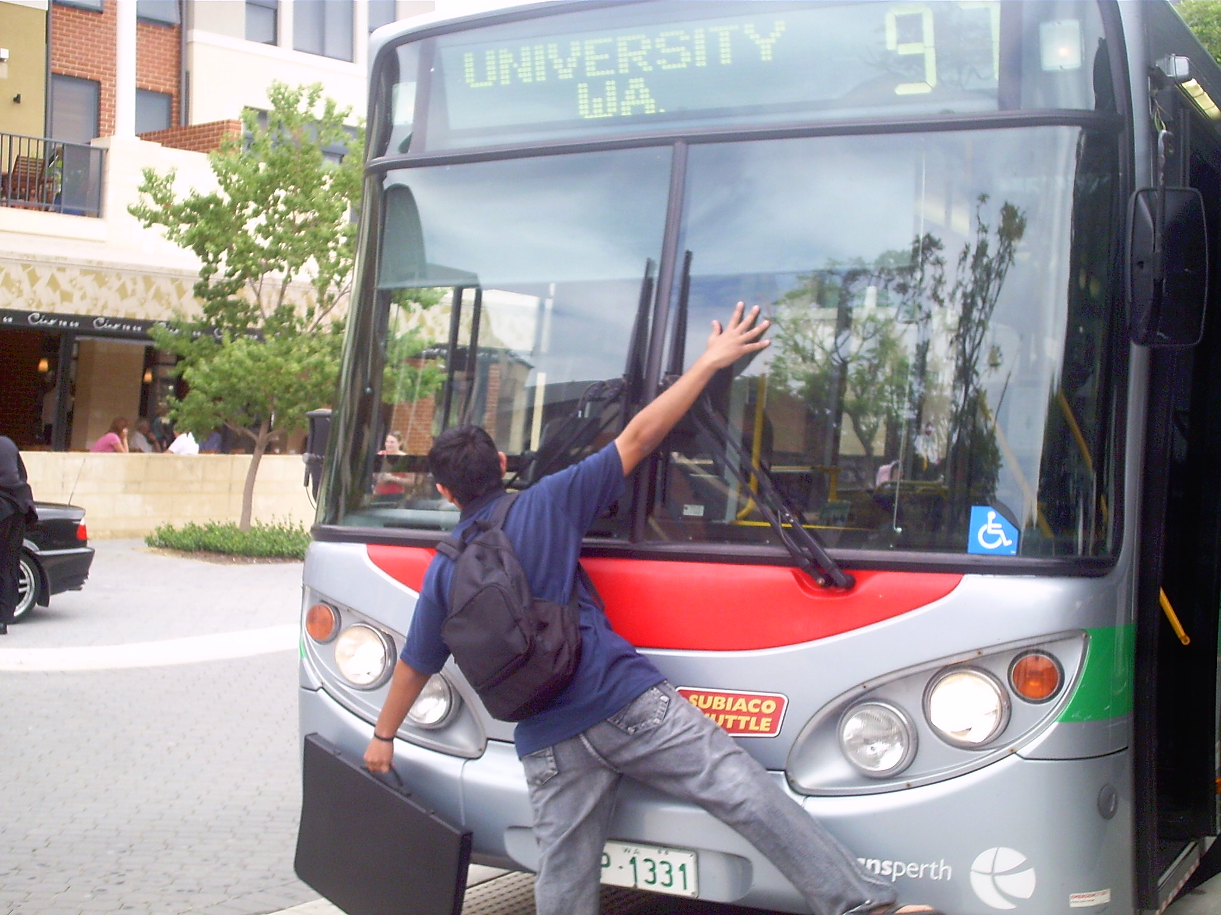
Your SysAdmin Got Hit by a Bus
Now What?

Slide 2

Your Typical SysAdmin

Slide 3

Evaluation

Slide 4
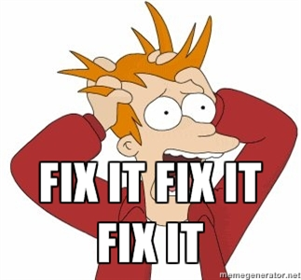
Remediation

